Slide 1
accessibility
statements
clearing the final hurdles
Alistair McNaught | McNaught Consulting
Huw Alexander | textBOX
Notes:
Title slide. The title of the webinar is, Accessibility statements, Clearing the final hurdles. The session is hosted by Alistair McNaught and Huw Alexander on behalf of ASPIRE education.

Slide 2
23 September 2020
Notes:
The deadline for the Public Sector Bodies accessibility regulation, 23 September, is fast approaching.

Slide 3
Accessibility Statement Survey 2020
textboxdigital.com/aspire-education-survey
Notes:
To help prepare the sector for the new regulations, ASPIRE education launched the accessibility statement survey 2020. The survey took the temperature of the sector as we approach the deadline – to measure levels of confidence.
Link: textboxdigital.com/aspire-education-survey

Slide 4
How ready is your institution for the launch of the new Public Sector Bodies Accessibility Regulations on 23 September?
Notes:
The overarching question we posed was: How ready is your institution for the launch of the new Public Sector Bodies Accessibility Regulations on 23 September?

Slide 5
How confident are you that your accessibility statement(s) is compliant with the Government Digital Services accessibility statement requirements?
Average score 6.57
Notes:
How confident are you that your accessibility statement(s) is compliant with the Government Digital Services accessibility statement requirements? Out of 10.
Score of 1 received 3.33 per cent.
Score of 2 received 0 per cent.
Score of 3 received 6.67 per cent.
Score of 4 received 0 per cent.
Score of 5 received 20 per cent.
Score of 6 received 13.33 per cent.
Score of 7 received 16.67 per cent.
Score of 8 received 26.67 per cent.
Score of 9 received 10.00 per cent.
Score of 10 received 3.33 per cent.

Slide 6
How confident are you that your accessibility statement is genuinely useful to disabled students?
Average score
5.33
Notes:
How confident are you that your accessibility statement is genuinely useful to disabled students? Out of 10.
Score of 1 received 6.67 per cent.
Score of 2 received 6.67 per cent.
Score of 3 received 3.33 per cent.
Score of 4 received 6.67 per cent.
Score of 5 received 23.33 per cent.
Score of 6 received 23.33 per cent.
Score of 7 received 23.33 per cent.
Score of 8 received 3.33 per cent.
Score of 9 received 3.33 per cent.
No scores for 10.

Slide 7
COMPLIANCE
6.57
A lack of confidence in the compliance of the institutional accessibility statement
USEFULNESS
5.33
A sense of doubt in the usefulness of the institutional accessibility statement
Notes:
Compliance score, 6.57. A lack of confidence in the compliance of the institutional accessibility statement
Usefulness score, 5.33. A sense of doubt in the usefulness of the institutional accessibility statement

Slide 8
What are the biggest barriers to implementing accessible practices at your institution?
Time
Lack of clear guidance
Staffing
Budgetary Concerns
Expertise
Management Buy-in
Notes:
What are the biggest barriers to implementing accessible practices at your institution?
Doughnut chart data as follows.
Time, 18 per cent.
Staffing, 18 per cent.
Management Buy-in, 18 per cent.
Expertise, 16 per cent.
Budgetary concerns, 12 per cent.
Lack of Clear Guidance, 6 per cent.
Disjointed Approach, 2 per cent.
Lack of training and understanding on requirements and writing statement, 2 per cent.
Working remotely when testing without access campus assistive technology, 2 per cent.
Lack of institutional focus, Functioning central team/roles, 2 per cent.
Institution wide lack of digital accessibility skills & knowledge, 2 per cent.
Lack of institutional focus, 2 per cent.
Volume of online content, 2 per cent.

Slide 9
senior management support
Notes:
Let’s take a closer look at securing senior management support and buy-in.

Slide 10
There is no silver bullet because there is no single cause of an inaccessible digital experience.
Accessibility will only become the norm when it is part of policy and practice.
There are 3 “layers” within the organisation to consider.
Notes:
There is no silver bullet because there is no single cause of an inaccessible digital experience.
Accessibility will only become the norm when it is part of policy and practice.
There are 3 “layers” within the organisation to consider

Slide 11
the big
accessibility
picture
Notes:
The 3 layers within an organisation to consider form the big accessibility picture.

Slide 12
Foundations
Accessible procure-ment
Policies & Quality assurance processes
Recruitment and job descriptions
Training and guidance
Policy layer
Notes:
Big picture – foundations
The foundation for the big picture is the policy layer which includes accessible procurement so that organisations do not waste money on purchasing inaccessible content that then needs to be made accessible or requires alternative solutions for disabled people. Secondly, policies and quality assurance processes are part of the policy layer because there is no point in people knowing how to be accessible or having the skills if the organisation does not validate its importance through quality assurance. Thirdly, recruitment and job descriptions are part of the policy layer. Many organisations have their biggest accessibility failures created by the marketing teams and their lack of accessibility awareness when creating brands, templates et cetera. If digital accessibility awareness is in all key job descriptions there are fewer uphill battles. Finally, training and guidance is important for every layer of the organisation. It is vital however that the training and guidance is contextualised to the role. The technical accessibility expectations you have for e-learning developers are quite different from the requirements you have for a health and social care lecturer.

Slide 13
Basement
Accessible platforms
Accessible templates
Accessible resources / activities
Technology layer
Accessible procure-ment
Policies & Quality assurance processes
Recruitment and job descriptions
Training and guidance
Policy layer
Notes:
Big picture – helipad
When the policy layer, technology layer and people layer are all in place your digital resources will result in barrier free learning. This represents a significant takeoff point for all students, particularly those with disabilities. It promotes independence, confidence and productivity.

Slide 14
Living Area
Digitally confident staff
Digitally confident students
People layer
Accessible platforms
Accessible templates
Accessible resources / activities
Technology layer
Accessible procure-ment
Policies & Quality assurance processes
Recruitment and job descriptions
Training and guidance
Policy layer
Notes:
Big picture – living area
Once the policy layer and technology layers are in place accessibility depends on the people layer. Do you have digitally confident staff who know how to create accessible presentations and documents? Do you have digitally confident students who know how to benefit from the inbuilt accessibility features in their phones, laptops, tablets and everyday software tools?

Slide 15
Helipad
Barrier free learning
Digitally confident staff
Digitally confident students
People layer
Accessible platforms
Accessible templates
Accessible resources / activities
Technology layer
Accessible procure-ment
Policies & Quality assurance processes
Recruitment and job descriptions
Training and guidance
Policy layer
Notes:
Big picture – helipad
When the policy layer, technology layer and people layer are all in place your digital resources will result in barrier free learning. This represents a significant takeoff point for all students, particularly those with disabilities. It promotes independence, confidence and productivity.

Slide 16
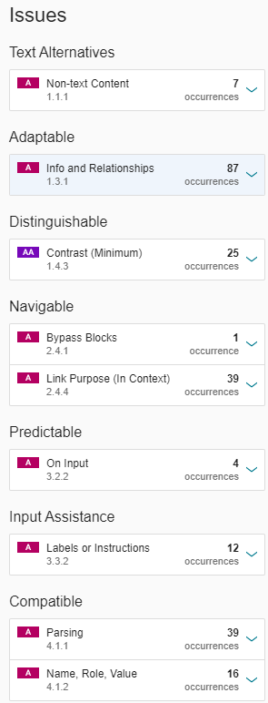
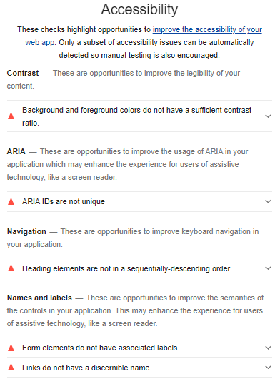
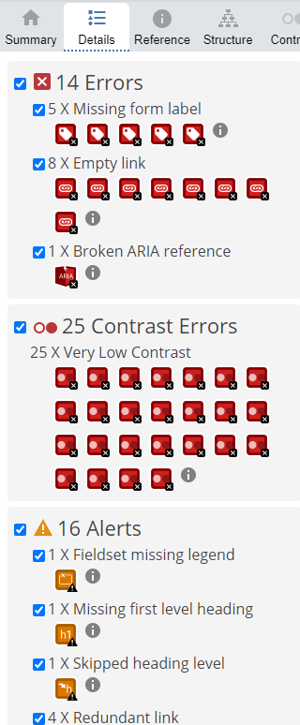
3 minutes from risk
SITEIMPROVE
WAVE
LIGHTHOUSE
Notes:
3 minutes from risk. An eye-opening approach is the ease with which a few simple online tests of a website can lead to a complaint or even legal action.

Slide 17
One college, one click (SiteImprove), many issues.
Repeat (Wave, Lighthouse)
Compare with accessibility statement.
Contact solicitor.
Evidence (para 12 (a), (b))
‘A “failure to make a reasonable adjustment” in this regulation means a failure to make a reasonable adjustment for the purposes of—
(a) sections 20, 21 and 29 of the Equality Act 2010; or
(b) sections 19 to 21 and 21B to 21E of the Disability Discrimination Act 1995(13).’
Notes:
One college, one click (SiteImprove), many issues.
Repeat (Wave, Lighthouse)
Compare with accessibility statement.
Contact solicitor.
Evidence (para 12 (a), (b)) as follows.
‘A “failure to make a reasonable adjustment” in this regulation means a failure to make a reasonable adjustment for the purposes of—
(a) sections 20, 21 and 29 of the Equality Act 2010; or
(b) sections 19 to 21 and 21B to 21E of the Disability Discrimination Act 1995(13).’

Slide 18
devolved responsibilities
AUTHOR’S
RESPONSIBILITY
Page titles
Meaningful hyperlink text
Text alternatives for images (where needed) or mark decorative for eye-candy.
Heading structure for pages
Transcripts for video or captions
Colour contrast
Captions for video
Scene description for video
DEVELOPER/SYSTEM
RESPONSIBILITY
Tab order
Reflow and magnification
Skip links for keyboard users
Keyboard accessibility for menus, video controls etc.
Heading structure
Screenreader accessible forms and interactivities.
Screenreader error trapping.
SENIOR MANAGER
RESPONSIBILITY
Vision
Coherence
Risk assessment
Empowering
Facilitating
Policy integration
Job descriptions
Quality assurance and reporting
Notes:
Devolved Responsibilities. Things to look out for
AUTHOR’S RESPONSIBILITY
Page titles
Meaningful hyperlink text
Text alternatives for images (where needed) or mark decorative for eyecandy.
Heading structure for pages
Transcripts for video or captions
Colour contrast
Captions for video
Scene description for video
DEVELOPER/SYSTEM RESPONSIBILITY
Tab order
Reflow and magnification
Skip links for keyboard users
Keyboard accessibility for menus, video controls etc.
Heading structure
Screenreader accessible forms and interactivities.
Screenreader error trapping.

Slide 19
getting an audit done
Notes:
Let’s take a look at your options for getting an audit done.

Slide 20
where you may need support
DIY tools
GDS basic checklist
McNaught/James checklist template
LexDis accessibility toolkits.
University of Southampton Web2Access tests
See guidance on auditing a website
Professional audit – short form
AbilityNet FE/HE digital accessibility bundle
All Able
Professional audit – long form
AbilityNet (and others) deep audit
Notes:
Where you may need support.
DIY tools
GDS basic checklist LINK?
McNaught/James checklist template LINK?
University of Southampton Web2Access tests
See guidance on auditing a website
Professional audit – short form
AbilityNet FE/HE digital accessibility bundle
All Able
Professional audit – long form
AbilityNet (and others) deep audit

Slide 21
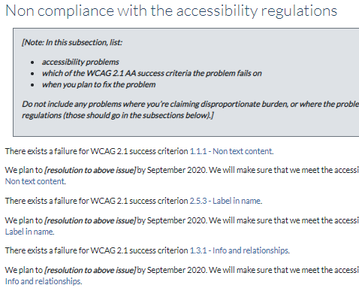
Late starting? Try the Web2Access Checker
https://web2access.org/reviews/new
Notes:
If you are late in starting the process of creating an accessibility statement, then try the new Web 2 Access service.
Link: https://web2access.org/reviews/new

Slide 22
third party content
Notes:
Let’s turn to the thorny issue of Third Party Content and offer some solutions.

Slide 23
What are the most challenging aspects about writing an accessibility statement?
Notes:
What are the most challenging aspects about writing an accessibility statement?
Doughnut chart data as follows.
Addressing third party content, 23 per cent.
Assessing and justifying disproportionate burden, 18 per cent.
Identifying non-compliant content, 18 per cent.
Making the statement user-focused and meaningful, 12 per cent.
Writing in plain English about technical matters, 12 per cent.
Identifying exceptions, 10 per cent.
Colleagues holding different meanings of the term, compliant, 1 per cent.
Getting teams responsible to write them, 1 per cent.
Identifying scope, 1 per cent.
Lack of ownership, 1 per cent.
Pulling it together to cover multiple component platforms, 1 per cent.
Producing evidence of testing, 1 per cent.

Slide 24
What is your current priority in meeting the new regulations?
Notes:
What is the current priority in meeting the new regulations?
Pie chart data
Writing the accessibility statement, 36 per cent.
Auditing the website to identify issues, 24 per cent.
Remediating Existing Content, 24 per cent.
Raising staff awareness, 4 per cent.
Replacing a particularly old and inaccessible system, 2 per cent.
Stem the flow of inaccessible content, 2 per cent.
Third party and satellite systems, 2 per cent.
Training staff and students, 2 per cent.
Video and audio, 2 per cent.
Gaining governance institution wide, 2 per cent.

Slide 25
close encounters of the third party kind
Addressing Third Party Content is a barrier
Third Party Content is a Priority
23%
2%
Notes:
Close encounters of the third party kind.
23 per cent of respondents stated that addressing third party content is a barrier.
2 per cent of respondents stated that addressing third party content is a priority.

Slide 26
third party content
Whose responsibility?
Pragmatic approaches:
searchBOX Directory + Finder
Missing/poor statement leads to reduced fee
Boiler plated templates to mix local (e.g. contact/support) and supplier elements.
textboxdigital.com/searchboxhome
Notes:
Third party content.
Whose responsibility?
Pragmatic approaches:
searchBOX Directory + Finder
Missing/poor statement leads to reduced fee
Boiler plated templates to mix local (e.g. contact/support) and supplier elements.
The searchBOX website is available: https://www.textboxdigital.com/searchboxhome

Slide 27
textboxdigital.com/searchbox-exchange
Notes:
Announcing searchBOX exchange and searchBOX reach.

Slide 28
disproportionate burden
Notes:
Next, let’s turn to Disproportionate burden.

Slide 29
handle with care
Non-compliant content.
accessibility problems, WCAG criteria, and plans to address the issue.
Exceptions
Content not within scope.
Disproportionate burden.
Accessibility problems that you consider would be a disproportionate burden to fix.
Notes:
Handle with Care
Non-compliant content.
accessibility problems, WCAG criteria, and plans to address the issue.
Exceptions
Content not within scope.
Disproportionate burden.
Accessibility problems that you consider would be a disproportionate burden to fix.

Slide 30
creating a meaningful statement
Notes:
How about the writing and creation of a meaningful statement?

Slide 31
the FACTS model
Formative: it makes users smarter at exploiting accessible content.
Actionable: it makes users resilient, helping them deal with inaccessible content.
Compliant: it keeps the organisation safe by covering the legal requirements.
Transparent: it keeps disabled users on board by being honest and accountable.
Supportive: it makes users confident by clarifying support options.
Notes:
The FACTS model weaves together compliance and usefulness to create a statement that meets user’s needs.
Formative: it makes users smarter at exploiting accessible content.
Actionable: it makes users resilient, helping them deal with inaccessible content.
Compliant: it keeps the organisation safe by covering the legal requirements.
Transparent: it keeps disabled users on board by being honest and accountable.
Supportive: it makes users confident by clarifying support options.

Slide 32
self-assessment activity
Specific or generic?
Plain English or technical?
Formative or merely factual?
Actionable or merely factual?
Compliant or copied?
Transparent or opaque?
Supportive or minimalist?
Score yours on this mentimeter activity.
www.menti.com
code 94 63 74
Notes:
Self-assessment activity.
Specific or generic?
Plain English or technical?
Formative or merely factual?
Actionable or merely factual?
Compliant or copied?
Transparent or opaque?
Supportive or minimalist?tivity.

Slide 33
a little help from your friends
Notes:
Finally, we’d like to provide you with some information and tools to help you on your journey. A little help from your friends.

Slide 34
advice
help
JISC COMMUNITY
ABILITYNET
GDS
LEXDIS ARCHIVES
W3C
ASPIRE RESOURCES
Notes:
Help Section, Part 1. Advice is available from the following sources recommended in the ASPIRE education survey.
Jisc Community.
AbilityNet
Government Digital Services.
Lexdis archives.
W, 3, C.
ASPIRE resources.

Slide 35
tools
help
WAVE
NVDA
ZOOM TEXT
WEB2ACCESS
BLACKBOARD ALLY
AXE
CHROMEVOX
HEADINGS MAP
SITEIMPROVE
MICROSOFT ACCESSIBILITY CHECKER
MICROSOFT ACCESSIBILITY INSIGHTS
WEBAIM CONTRAST CHECKER
FIREFOX ACCESSIBILITY
READ + WRITE GOLD
LEXDIS TOOLKIT
CHROME LIGHTHOUSE
TOTA11Y
SILKTIDE
JAWS
ANDI
Notes:
Help section, Part 2.
We asked the question, What are the most useful tools that you use in testing your website for accessibility? The results were as follows.
WAVE, 26 per cent.
Blackboard Ally, 11 per cent.
SiteImprove, 11 per cent.
NVDA, 6 per cent.
AXE, 6 per cent.
Microsoft Accessibility Checker, 6 per cent.
Zoom Text, 6 per cent.
ChromeVox, 3 per cent.
Accessibility Insights, 3 per cent.
Chrome Lighthouse, 3 per cent.
Firefox Accessibility, 3 per cent.
JAWS, 3 per cent.
Read and Write Gold, 3 per cent.
Tota11y, 3 per cent.
ANDI, 3 per cent.
LexDis Toolkit, 3 per cent.
Silktide, 3 per cent.

Slide 36
remediation
help
Remediating existing content:
AbilityNet: bespoke support with accessibility improvements and training.
codemantra: support for bulk transformation of PDFs.
Brickfield: Support for Moodle accessibility enhancements (Find, Fix, Futureproof).
Other tools embedded in the sector: Blackboard ALLY + Sensus Access.
Notes:
Help section, Part 2. Remediation.
Options available for remediating existing content:
AbilityNet: bespoke support with accessibility improvements and training.
codemantra: support for bulk transformation of PDFs.
Brickfield: Support for Moodle accessibility enhancements (Find, Fix, Futureproof).
Other tools embedded in the sector: Blackboard ALLY + Sensus Access.

Slide 37
statement writing
help
Consultancy services:
ASPIREeducation + All Able writing support.
ASPIREeducation self-assessment tool.
ASPIREeducation review + scoring service.
AbilityNet accessibility statement mapping service.
Notes:
Help, Part 4. Statement writing.
Consultancy services are available.
ASPIRE education + All Able writing support.
ASPIRE education self-assessment tool.
ASPIRE education review + scoring service.
AbilityNet accessibility statement mapping service.

Slide 38
The FACTS framework is open access + available for download.
textboxdigital.com/aspire-education-guidelines
Notes:
The FACTS framework is open access + available for download.
textboxdigital.com/aspire-education-guidelines

Slide 39
model statement
allable.co.uk/research/aspire-education-model-statement
Or try
Education and Training foundation Accessibility Statement
Notes:
The model accessibility statement for institutions is available here at the All Able: allable.co.uk/research/aspire-education-model-statement
Or Education and Training foundation Accessibility Statement

Slide 40
IDEAS
TOOLS
SUPPORT
Notes:
We hope we have provided you with some ideas to help you create compliant and user-focused accessibility statements. There are a wide selection of tools and sources of support and advice available.

Slide 41
What is current priority in meeting the new regulations?
Notes:
As we come to an end, we’d like to return to the question, What is current priority in meeting the new regulations? The top 3 answers were as follows.
Writing the accessibility statement, 36 per cent.
Auditing the website to identify issues, 24 per cent.
Remediating existing content, 24 per cent.
We would like to address these in more depth and provide you with some expert advice.

Slide 42
encore
Notes:
To that end, we are providing an encore to today’s session.

Slide 43
join us on 18 September
Exploring the Accessibility Maturity model + the Digital Inclusion bundle with Amy Low.
Accessibility statement audits and support with Ben Watson + George Rhodes
Moodle accessibility plugin – Find, Fix and Futureproof with Gavin Hendrick
PDF bulk auditing and bulk conversion with Mark McCallum + Ian Smith
https://www.eventbrite.co.uk/e/accessibility-answered-addressing-your-accessibility-questions-tickets-120262397067
Notes:
Join us on 18 September to hear from 4 expert vendors:
Abilitynet: Exploring the Accessibility Maturity model + the Digital Inclusion bundle with Amy Low.
All Able: Accessibility statement audits and support with Ben Watson + George Rhodes.
Brickfield: Moodle accessibility plugin – Find, Fix and Futureproof with Gavin Hendrick.
codemantra: PDF bulk auditing and bulk conversion with Mark McCallum + Ian Smith.
Registration link:
https://www.eventbrite.co.uk/e/accessibility-answered-addressing-your-accessibility-questions-tickets-120262397067

Slide 44
questions
enquiries@alistairmcnaught.co.uk
huw@textboxdigital.com
aspire@textboxdigital.com
@ASPIRElist
textboxdigital.com
Notes:
Questions and contact details.

