Slide 1




accessibility. answered.
addressing your accessibility questions
with special guests

Slide 2


agenda
SLIDES + VIDEO
12.00. Exploring the Accessibility Maturity model + the Digital Inclusion bundle with Amy Low + Helen Wickes
12.20. The challenges of bulk audits and bulk remediation with Mark McCallum + Ian Smith
12.40. Moodle accessibility plugin – Find, Fix and Futureproof with Gavin Henrick
13.00. Accessibility statement audits and support with Ben Watson + George Rhodes from All Able.
13.20. Writing useful statements + more with Alistair McNaught + Huw Alexander from ASPIREeducation.
13.40. Panel

Slide 3
AbilityNet
Answering your accessibility questions including the Accessibility Maturity model and the Digital Inclusion bundle.
Amy Low + Helen Wickes
Twitter: @AbilityNet
Web: abilitynet.org.uk

Slide 4
Answering your accessibility questions
AbilityNet
Amy Low, Service Delivery Director
Helen Wickes, Education and Workplace Relationship Manager

Slide 5

AbilityNet: A Digital World Accessible to All
“We support people of any age, living with any disability or impairment, to use technology to achieve their goals at home, at work and in education.”

Slide 6

What we will cover today
What do you want to know?? – common accessibility related questions we hear
Identifying barriers – digital accessibility and student journeys
Evaluating Institutional Accessibility Maturity
Support for prospective and existing students with digital accessibility

Slide 7

What do you want to know? - Institutions
  How accessible are we?
  Where do we start?
  What are the risks?
  How do I sell the benefits?
  How do we make this business as usual?

Slide 8
What do you want to know? – Students & parents/advisors
  How do I decide what to study?
  Will my needs be considered?
  What can I refer to to provide guidance to my child / student in my care about their study choices?

Slide 9
Advice - Institutions
How accessible are we? Technical, cultural and user focused considerations
Where do we start? Prioritise, set a benchmark and make a plan
What are the risks? Not clear yet BUT positive action and forward planning best line of defence
How do I sell the benefits? Carrot over stick, link to student experience, journey and continuous improvement
How do we make this business as usual? Big picture strategy AND module level scrutiny/student voice and choice

Slide 10
Advice – Students & parents/advisors
  How do I decide what to study? – postcode lottery, some ways you can start to weigh up options
  Will my needs be considered? – some signals you can look for and questions to ask
  What can I refer to to provide guidance to my child / student in my care about their study choices? – as above
  Isn’t there a simpler way??

Slide 11

Services that can help – Technical and student journey
  Digital Accessibility Inclusion Bundle :
    Inclusion overview
    Accessibility review
    Statement mapping session (FACTS)
  Audits and headline reviews – cover a wide range of sites to prioritise work

Slide 12
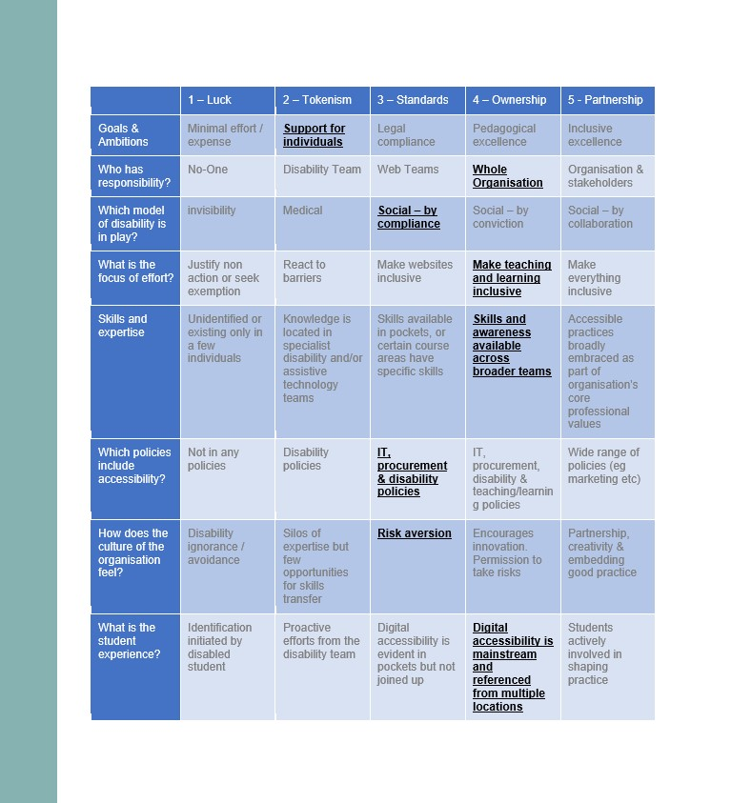
Services that can help - frameworks
  Accessibility Maturity planning – frameworks to evaluate institutional cultural and structural accessibility as well as module level
  Institution and module level badging – guidance to staff to help them maintain standards and improve and information and reassurance to existing and prospective students that their needs are supported

Slide 13
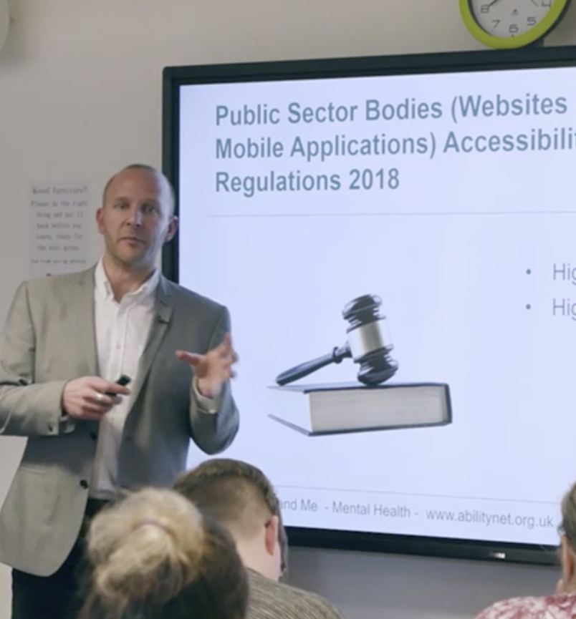
Services that can help – knowledge and training
  Ad Hoc consultancy – help and support solving challenges
  Training – technical, cultural, lived experience and pedagogical

Slide 14
AbilityNet Online Training Series
24th Sept: Accessibility testing in mobile apps
1st Oct: How to create accessible document and presentations
8th Oct: Creating accessible graphics and social content
Get 10% off any of our future online training courses this year using discount code ASPIRE10 at abilitynet.org.uk/training

Slide 15
codemantra
The challenges of PDF bulk auditing and bulk conversion.
Mark McCallum + Ian Smith
Twitter: @codemantra
Web: codemantra.com

Slide 16
Our Experience
Client
PDFs
The challenges of bulk audits and bulk remediation
Ian Smith & Mark McCallum

Slide 17

Our Experience
Digital document accessibility audit
Client

Slide 18
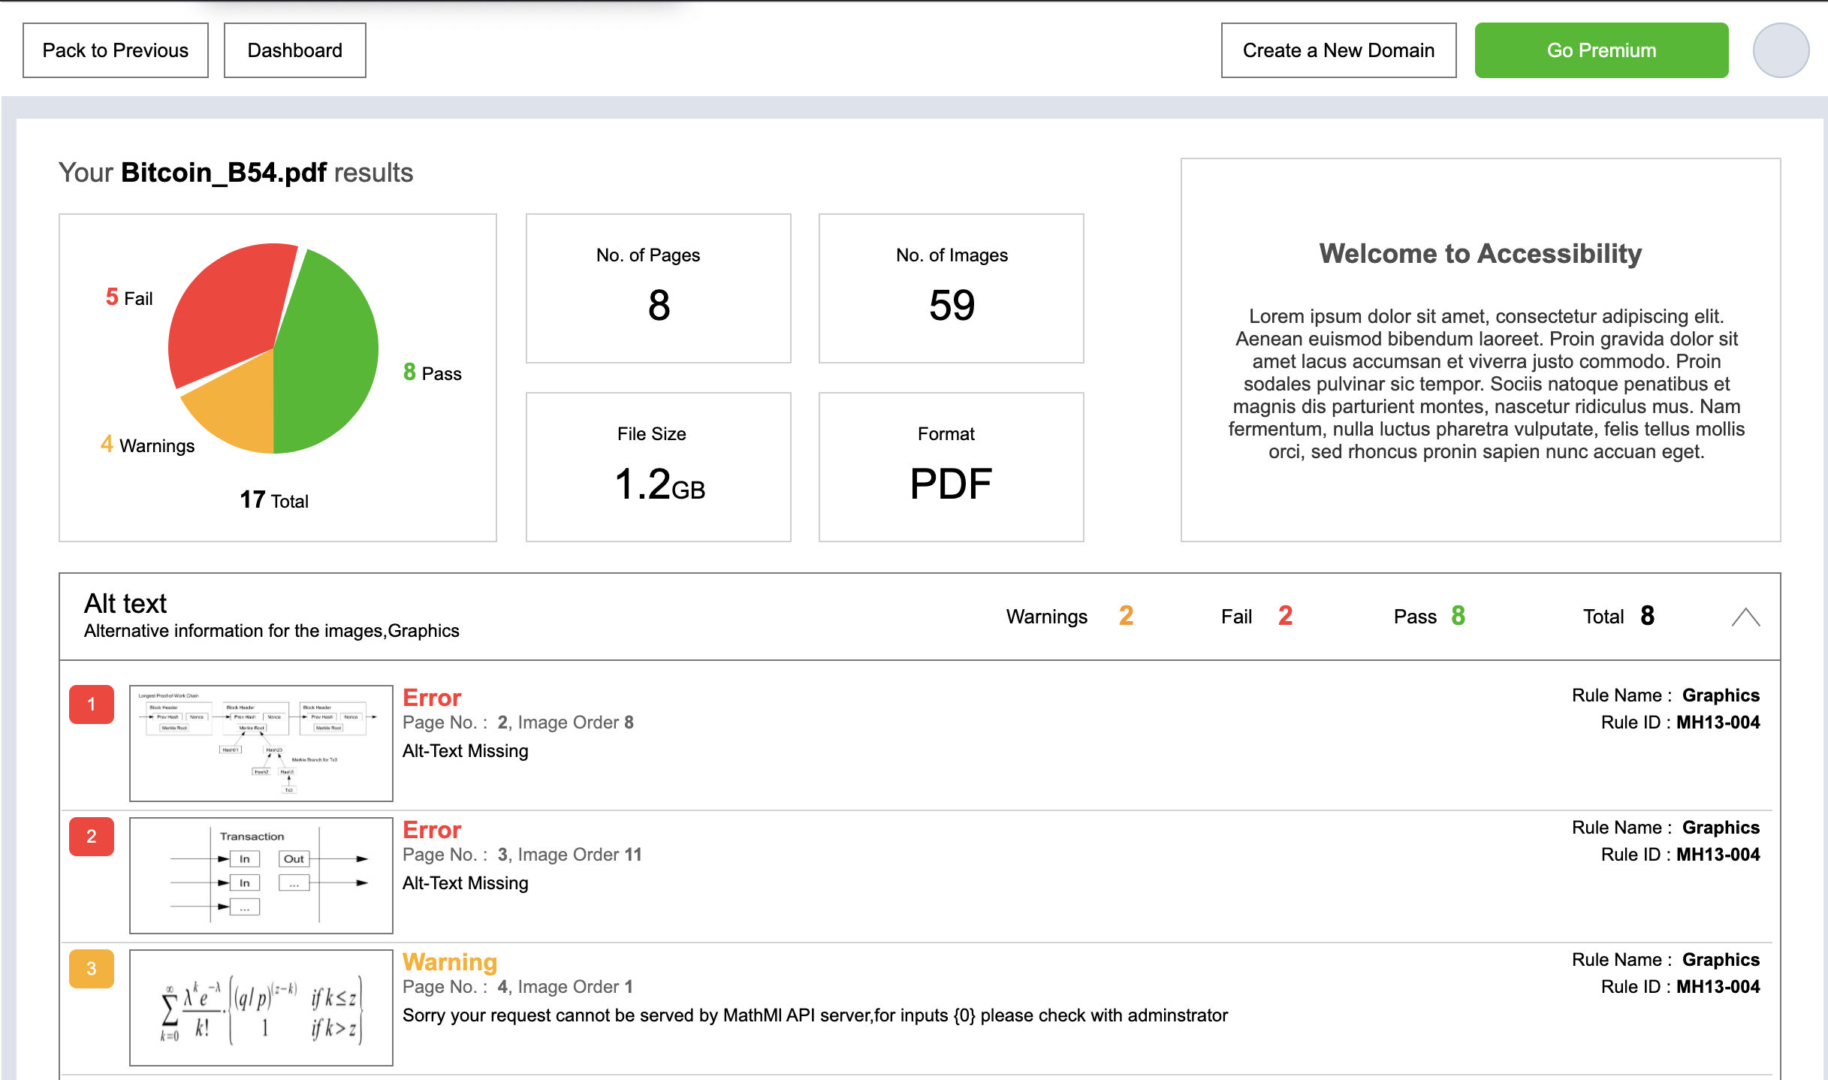
Our Experience
Digital document accessibility audit
Client

Slide 19
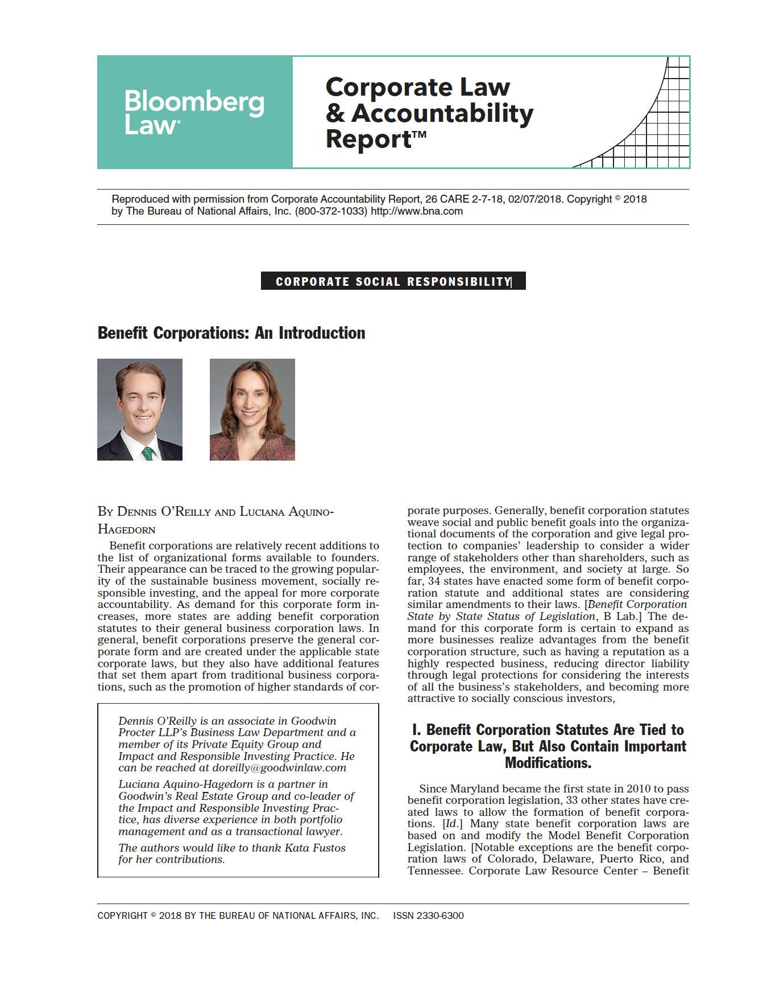
Our Experience
PDF and structure
Client
The challenge: replicate visual cues, such as document sections, reading order, context and relationship for an accessible document

Slide 20
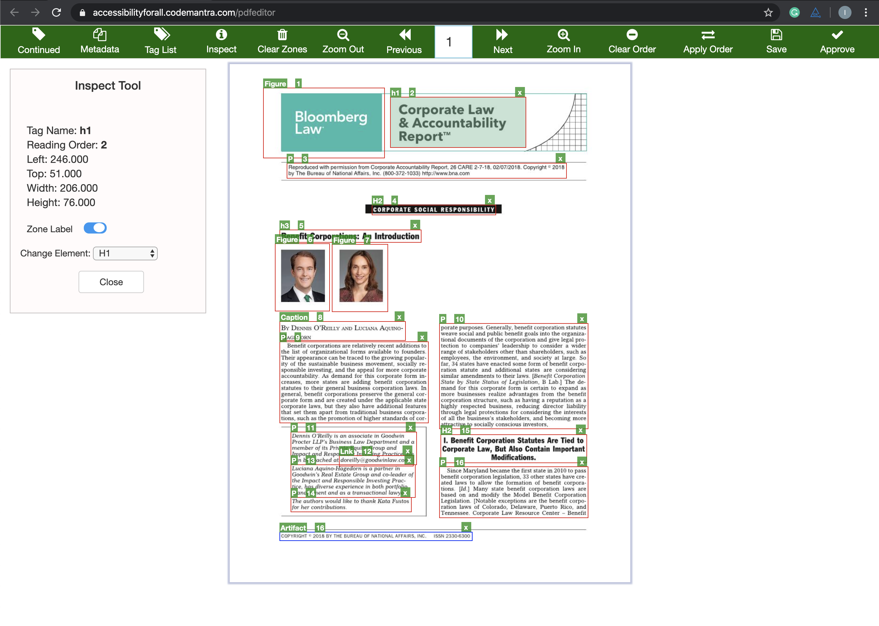
Our Experience
PDF and structure
Client
Automated structuring to ensure genuine accessibility

Slide 21
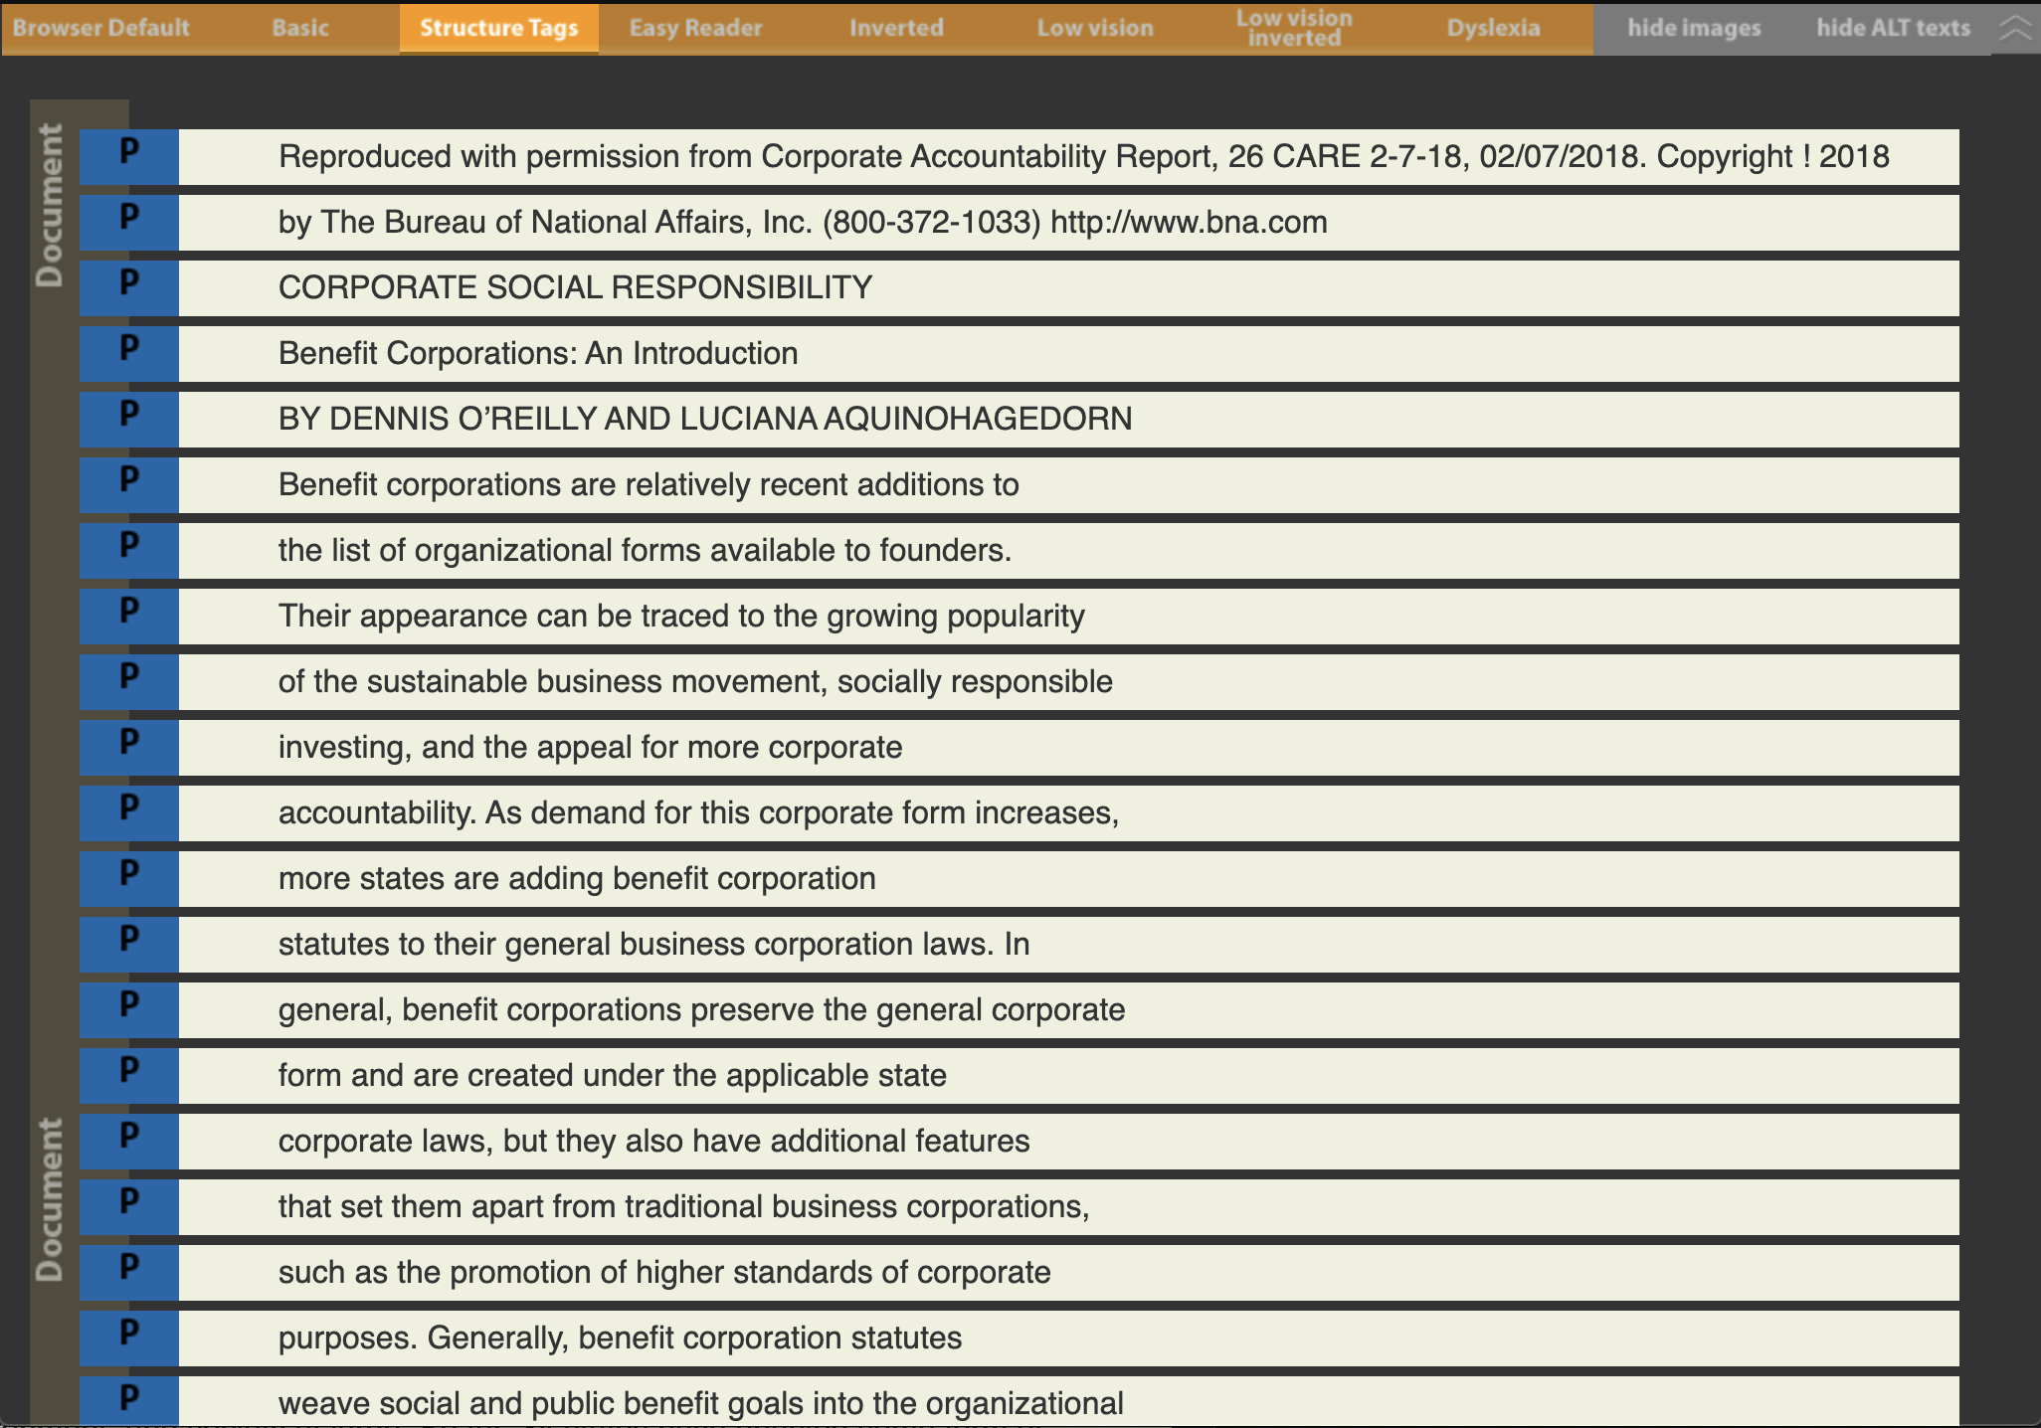
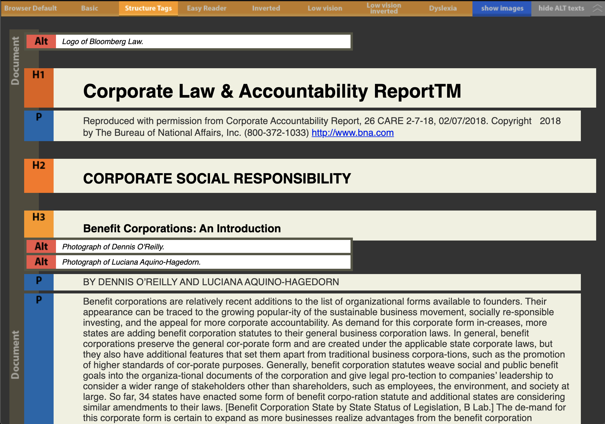
Our Experience
PDF and structure
Client
Unstructured
Structured

Slide 22
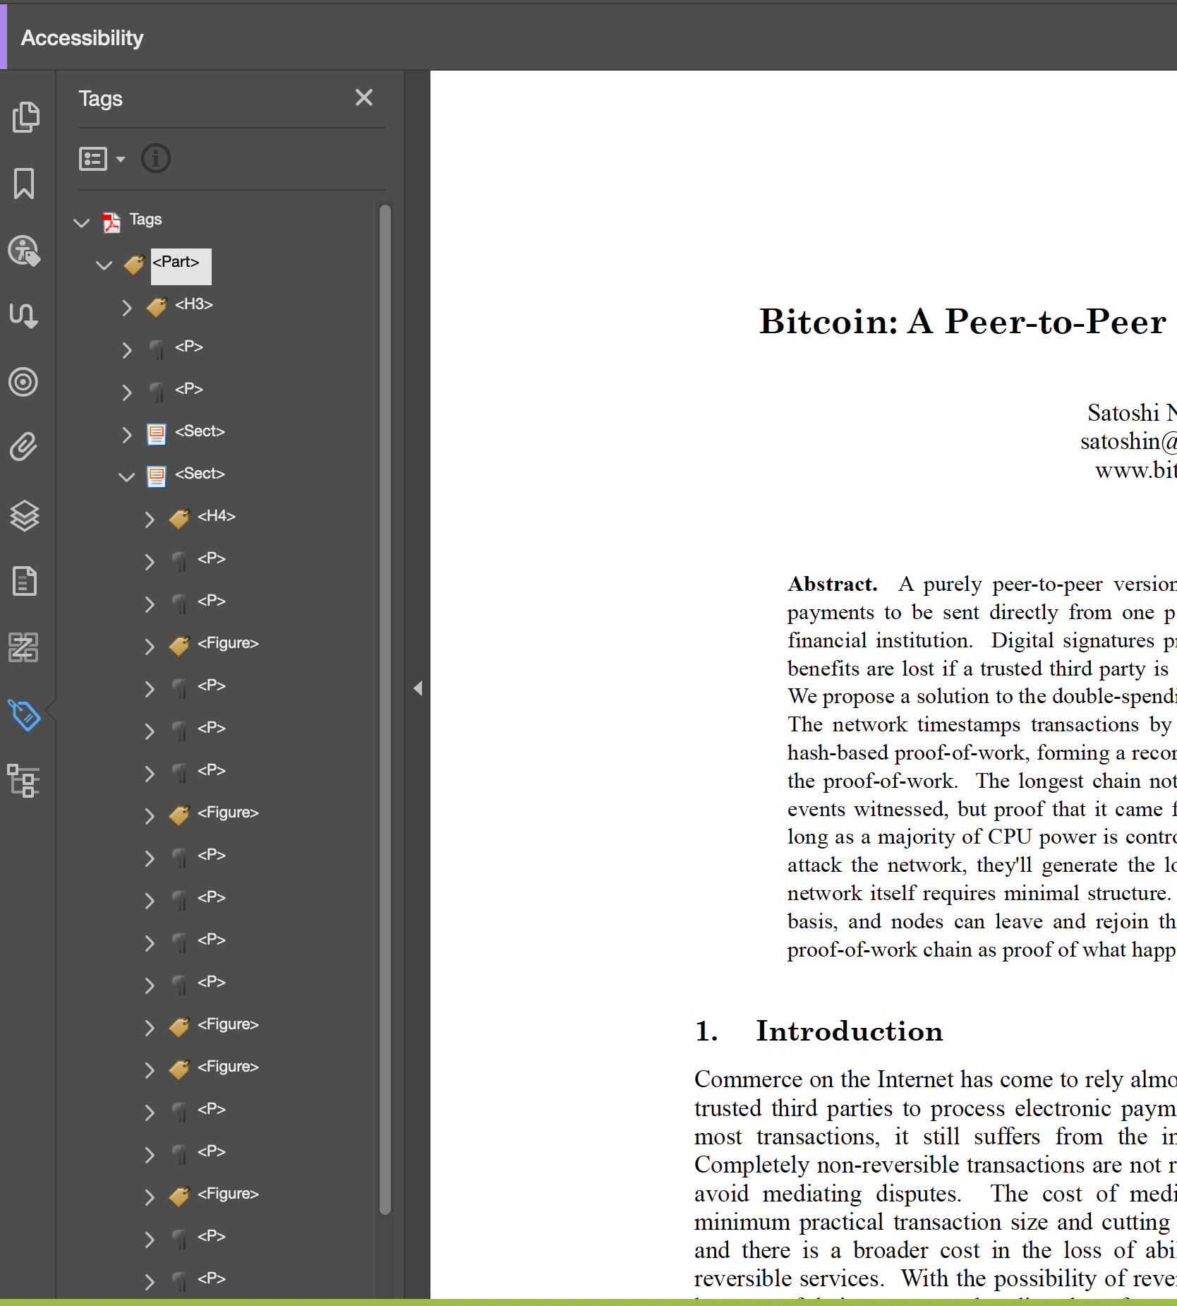
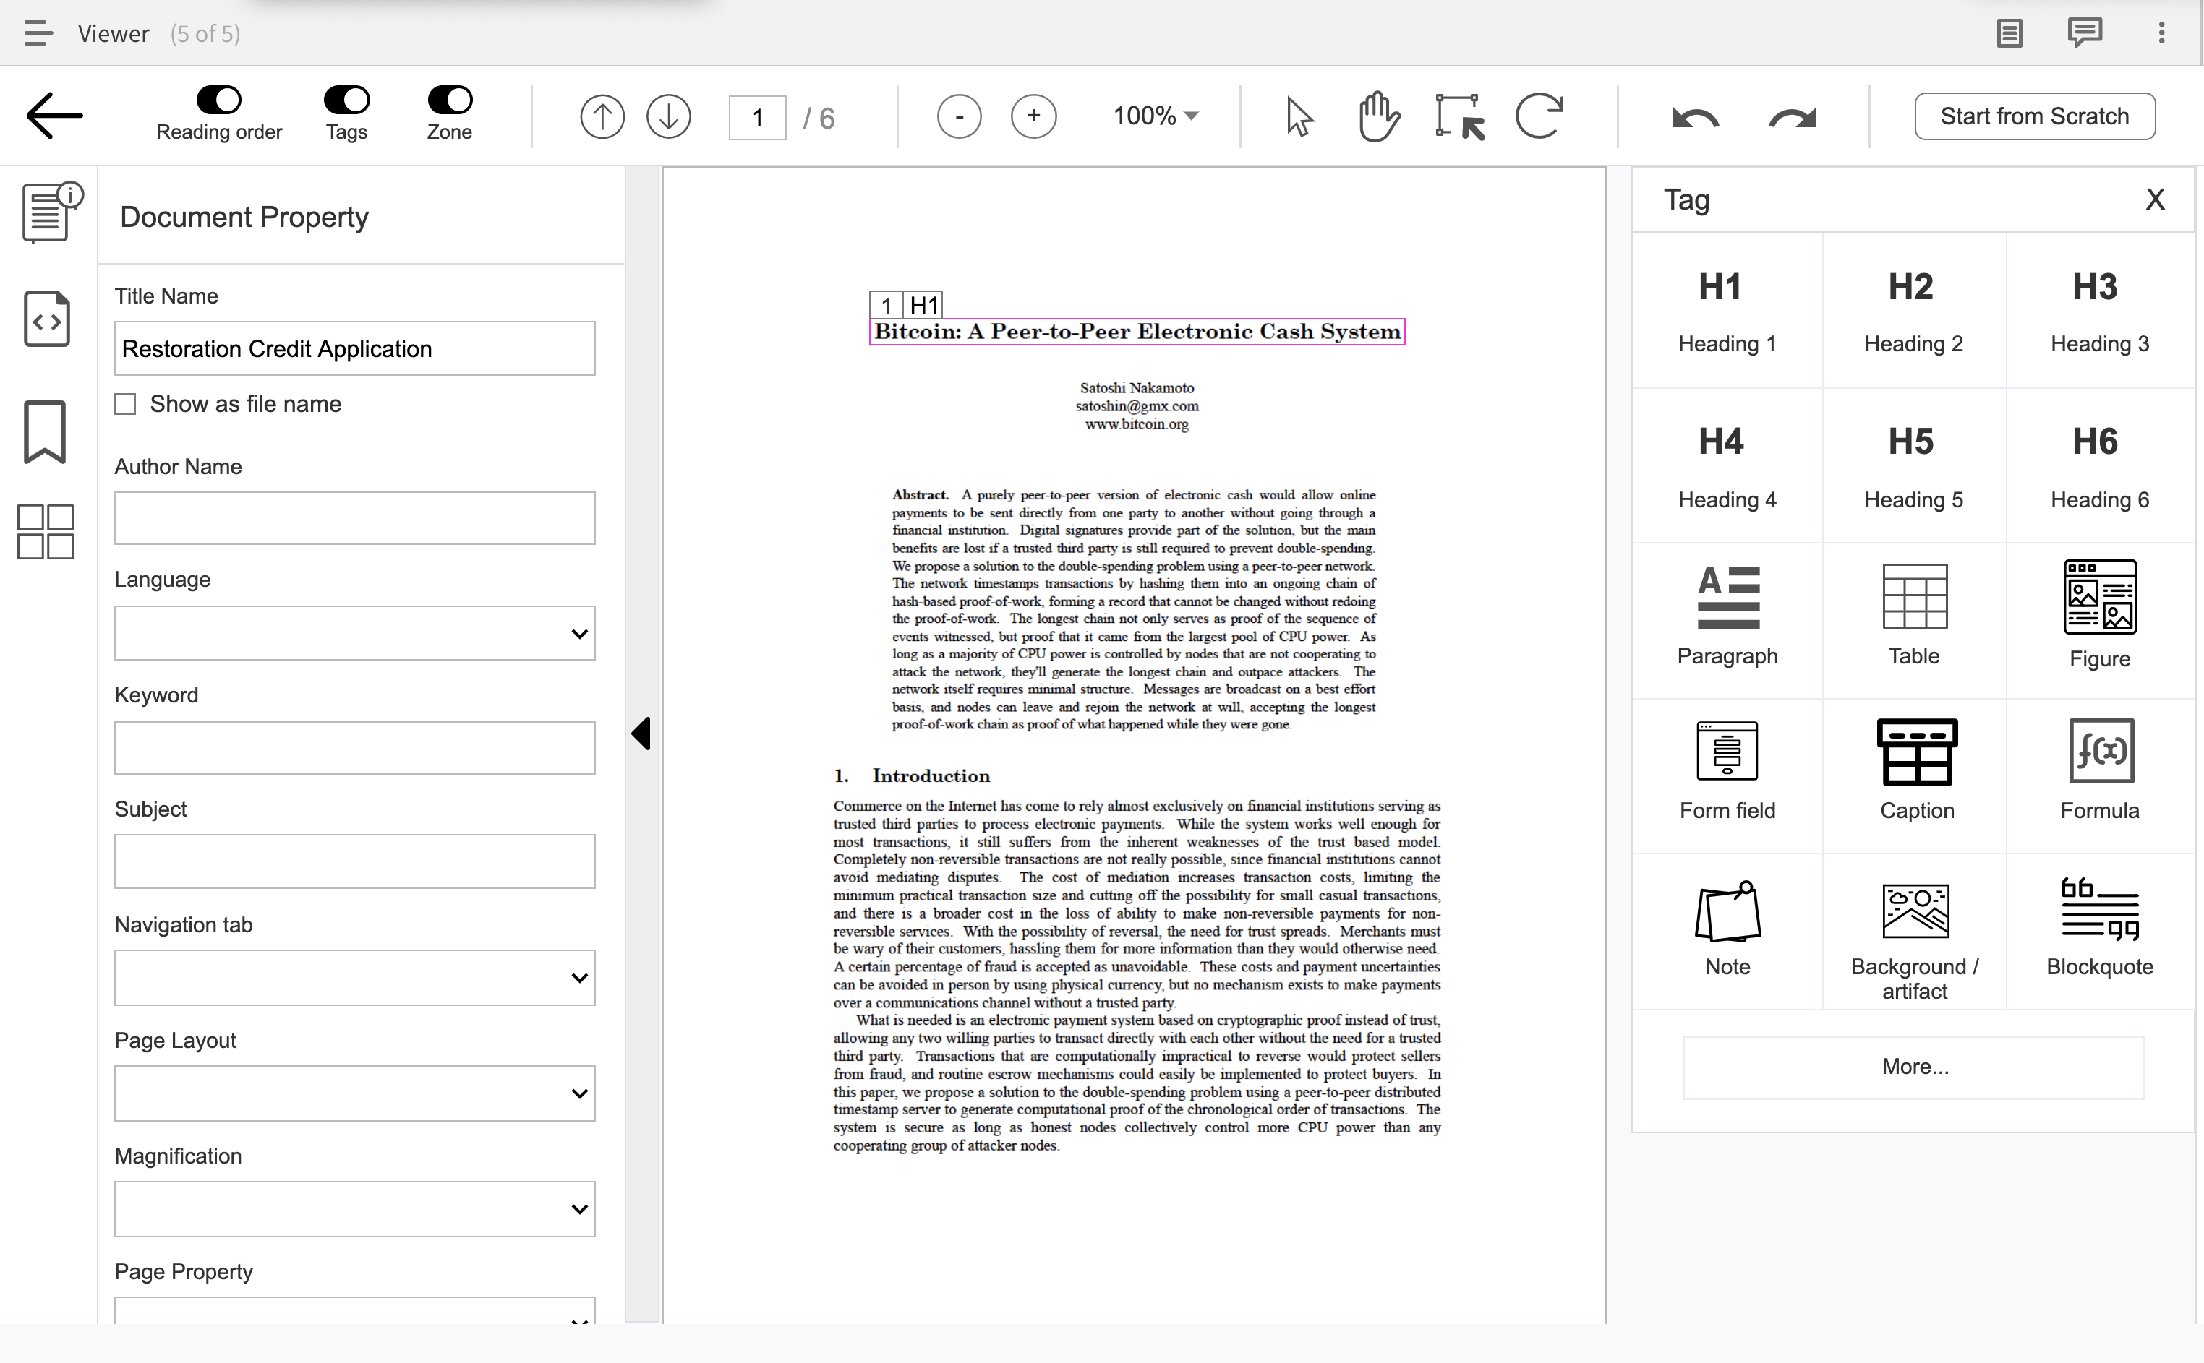
Our Experience
PDF accessibility challenges and solutions
Client

Slide 23
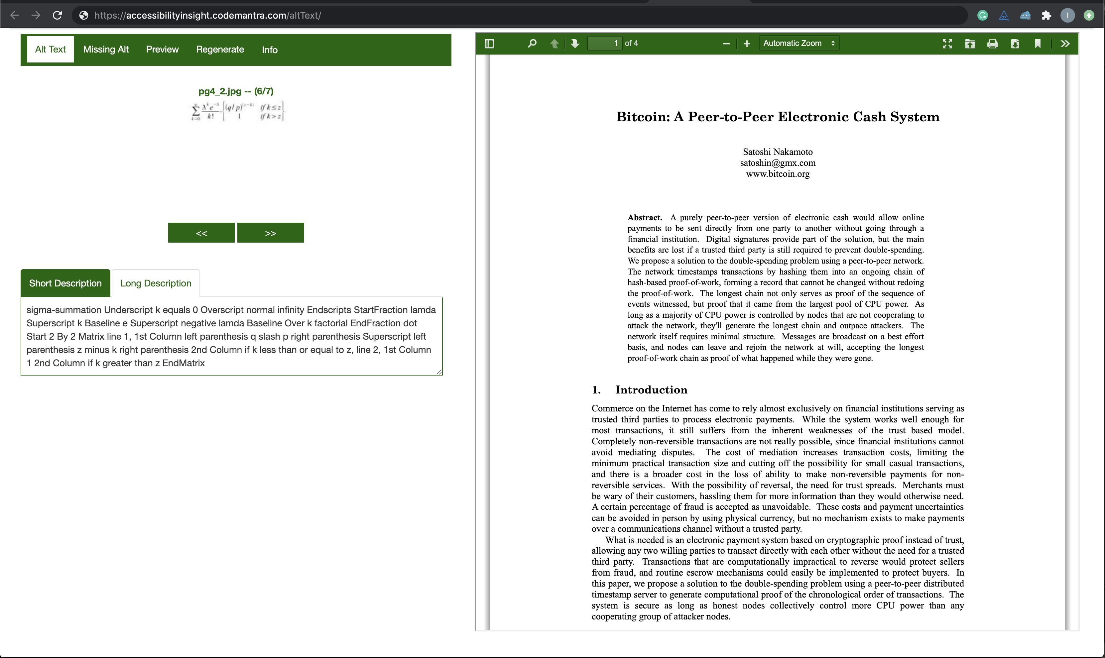
Our Experience
Alt text management
Client
Intuitive user interface to write and review alternative text descriptions

Slide 24

Get in touch
Get in Touch
THANK YOU
Corporate Office:
1500 District Avenue,
Burlington,
MA 01803
UK Office:
Moor Place, 1 Fore St Ave,
London, EC2Y 9DT
+44 (0) 7557768543
India Office:
IIFL Tower, 3rd Floor,
No 143,MGR Main Road,
Kandanchavadi, Perungudi,
Chennai - 600 096
+91 44 66155300
US
UK
IN
ismith@codemantra.com

Slide 25
Brickfield
Moodle accessibility plugin – Find, Fix and Futureproof.
Gavin Henrick
Twitter: @brickfieldlabs
Web: brickfield.ie

Slide 26

Enhancing the building blocks of effective education

Slide 27

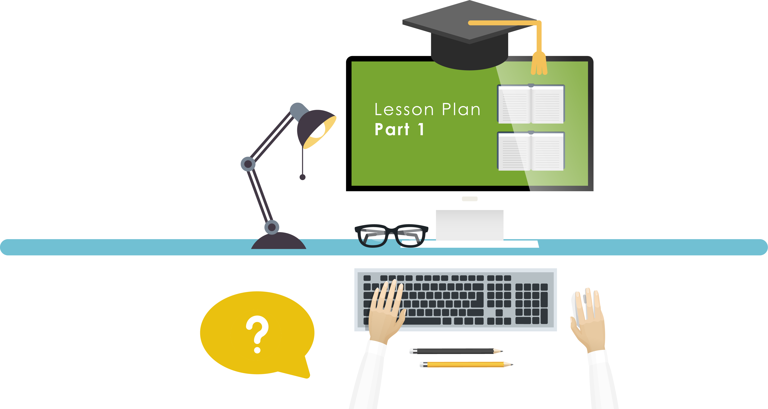
Are your LMS lessons compliant?

Slide 28

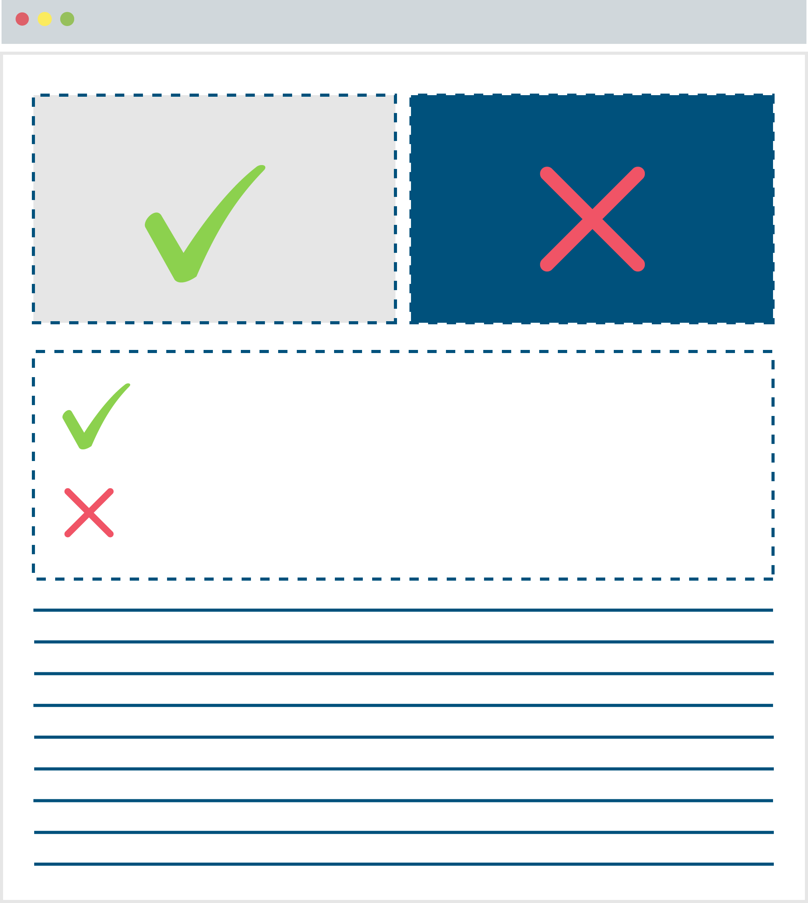

Technical content standards
Difficult Technical Formatting
Display Guidelines
Not Compliant
Struggle to stay
Compliant

Slide 29
Some Problems
Many staff are content and discipline experts and not accessibility aware
Institution doesn’t know how compliant they are and doesn’t know what needs to be fixed – and fixing is a manual intensive process
People are not intentionally ignorant of accessibility and associated legal requirements

Slide 30
The Solution

Slide 31
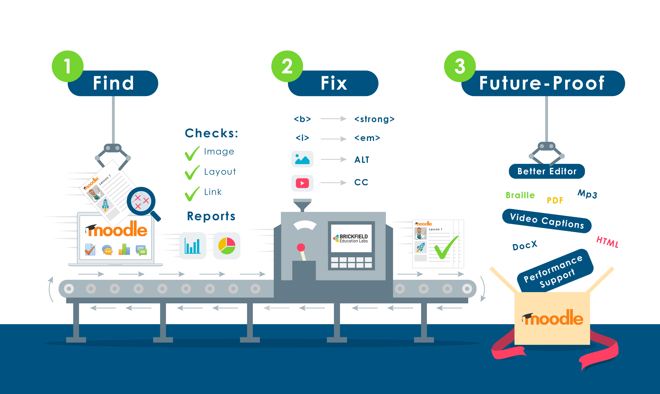

Slide 32
Accessibility Toolkit
Find the existing issues with the content
Fix the issues automatically, and provide interfaces to triage
Futureproof the content building by improvements to Moodle

Slide 33
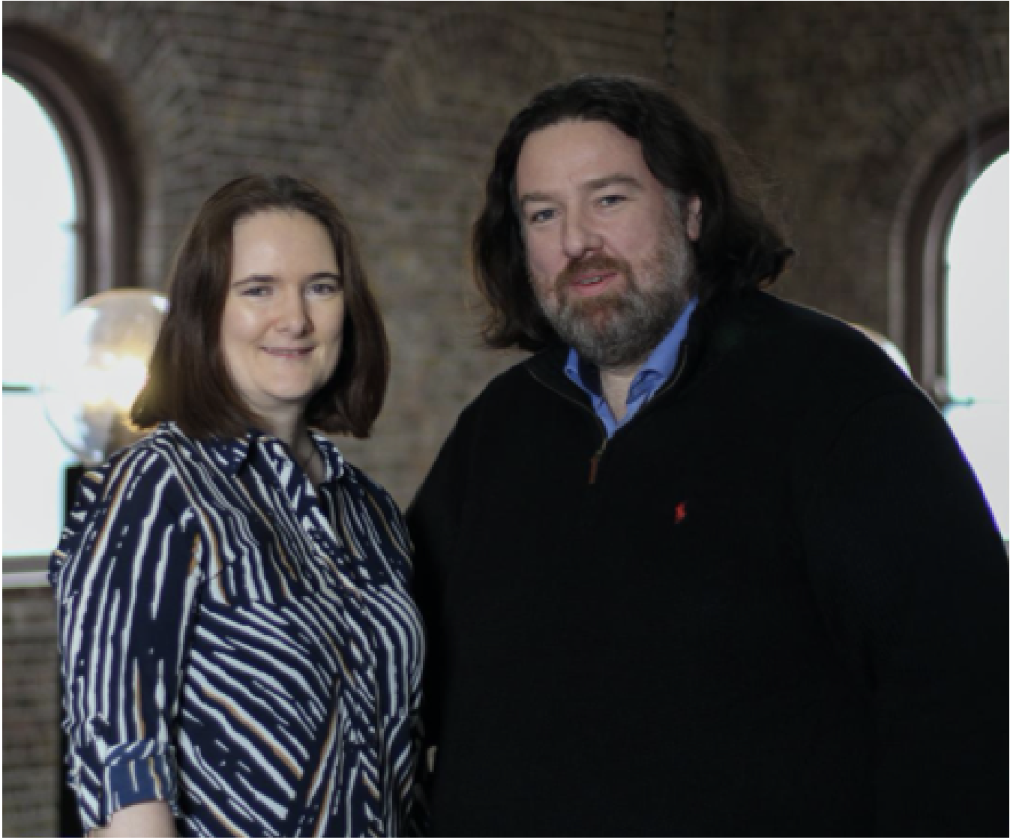





Gavin Henrick
Enhancing the building blocks of effective education
gavin@brickfield.ie
+353 87 640 4000
Brickfield Education Labs
www.brickfield.ie
@ghenrick
Skype: gavin.henrick

Slide 34
All Able
Accessibility statement audits and support.
Ben Watson + George Rhodes
Twitter: @all_able
Web: allable.co.uk

Slide 35
Accessibility statement audits and support
Ben Watson and George Rhodes
Twitter: @all_able Web: allable.co.uk

Slide 36

What are accessibility statements?
Accessibility statements are a document you are legally required to have for all websites from the 23rd September 2020
The deadline is only a few days away!
Statements are meant to show your legal compliance with the regulations
But more importantly they are there to support users with additional or alternative access needs to make sure that everyone can have the best experience possible with your website, content or service

Slide 37
Government guidance and compliance
There is government guidance on making your websites accessible and a sample statement to show you what GDS expect a statement to contain
All of this comes from the regulations and model accessibility statement
The requirements are complicated and very specific around some wording
The guidance does not always help with many examples we have seen people struggle with
Just because something is compliant does not mean that it is useful

Slide 38
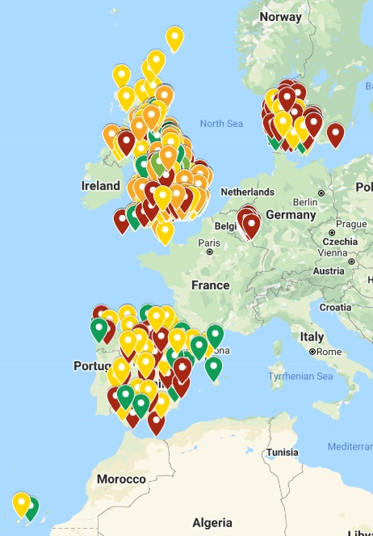
We know statements
We have looked at thousands of statements across several countries
We are speaking at a European Commission event next week to mark the regulations deadline as experts on statements
We know what a good statement looks like

Slide 39
How testing leads to better statements
A good statement cannot be written without first knowing what accessibility issues there are
Thorough testing can help you identify these issues and what you can do about them
You can develop testing skills yourself or you can get support from experts to ensure you are getting the best advice possible
All Able offer thorough auditing to help you monitor the accessibility of your services
Testimonials
It made the entire process of ensuring website accessibility easier and less stressful.
I was getting concerned that my website may not be fully accessible. All Able gave me the confidence I needed to complete this project.

Slide 40
Support in writing a statement makes for better user experience
Now you have your audit results you need to turn this into an accessibility statement
How do you take this technical compliance information and turn it into something useful?
Alistair and Huw will talk about this in more detail next but the main thing is to consider how you can articulate the issues as clearly as possible and provide as much additional information to ease the user experience.
All Able, textBOX and McNaught Consulting can help you ASPIRE to the best statement you can create.

Slide 41




ASPIREeducation accreditation
Audit your services
Get support in writing the best statement possible
Know that you are providing the best support
Deliver accessible services
Reduce legal risk
Be an example of best practice
Show maturity
Twitter: @all_able Web: allable.co.uk

Slide 42
ASPIREeducation
Writing useful statements + more
Alistair McNaught + Huw Alexander
Twitter: @ASPIRElist
Web: textboxdigital.com/aspire-home

Slide 43

Giving users the FACTS
Formative: making users smarter.
Actionable: making users resilient.
Compliant: keeping the organisation safe.
Transparent: keeping disabled users on board.
Supportive: making users confident.
Notes:
The FACTS principles:
Formative: making users smarter.
Actionable: making users resilient.
Compliant: keeping the organisation safe.
Transparent: keeping disabled users on board.
Supportive: making users confident.
More details below:
Formative: The information about the accessibility of the website helps inform users how to exploit digital accessibility for their personal productivity and comfort.
Actionable: Any information about accessibility barriers is specific so users can anticipate actions they may need to take, for example requesting alternative formats or seeking support.
Compliant: The accessibility statement covers all legally requirements.
Transparent: Relevant documentation is available relating to risk assessments, priorities and disproportionate burden.
Supportive: Contact information, response times and communication processes are supportive. Self-help resources are available where appropriate.

Slide 44
Formative | Actionable | Compliant
Formative:
Good example: "We have used heading styles to create an easily navigable hierarchical structure to all our text content. This allows blind users with screen readers to navigate pages very efficiently. Browser plug-ins such as Headings map for Chrome/Firefox allows sighted users to instantly navigate to the relevant part of the page.
Poor example: "Pages are structured using heading styles”
Actionable:
Good example: "The online forms for requesting a prospectus and applying for halls of residence are not accessible to screen readers. Alternative contact details are provided on those pages.”
Poor example: “Not all the forms on our website work with screen readers.”
Compliant: The accessibility statement covers all legal requirements on GDS sample statement.
Notes:
Formative | Actionable | Compliant
Formative:.
Good example: "We have used heading styles to create an easily navigable hierarchical structure to all our text content. This allows blind users with screen readers to navigate pages very efficiently. Browser plug-ins such as Headings map for Chrome/Firefox allows sighted users to instantly navigate to the relevant part of the page.
Poor example: "Pages are structured using heading styles”
Actionable:
Good example: "The online forms for requesting a prospectus and applying for halls of residence are not accessible to screen readers. Alternative contact details are provided on those pages.”
Poor example: “Not all the forms on our website work with screen readers.”
Compliant: The accessibility statement covers all legal requirements

Slide 45
Transparent | Supportive
Transparent:
Good example: "The 3D virtual reality tours have no audio options for blind users. The suppliers quote £8,000 - £10,000 to make each tour accessible. This would benefit less than 4 students in a typical year. We believe this is a disproportionate burden. Blind students can already access 1:1 orientation training. We plan to keep using the 3D virtual tour which benefits around 200 students with anxiety and mobility issues.”
Poor example: “We have several interactivities on the site. Fixing these would be a disproportionate burden.”
Supportive:
Contact information, response times and processes are explicit and supportive. Self-help resources are available where appropriate.
Good example: “Contact us through the email address or dedicated phone number below. We will endeavour to get back in touch with you in 2 working days. If the request will take longer than that, we will contact you to discuss options and alternatives. We can provide accessible alternatives in digital format much more quickly than physical formats such as large print or Braille.”
Poor example: "If you have a problem email reception@university.ac.uk.”
Notes:
Transparent | Supportive
Transparent:
Good example: "The 3D virtual reality tour has no audio feedback available for blind users. We approached the developers for advice on adding audio. We were informed that audio feedback would require a rebuild of the code base at around 10 times the cost of the current software and would benefit less than 4 students in a typical year. We believe this is a disproportionate burden because the current version benefits around 200 students with anxiety and mobility issues. Blind students have access to our 1:1 support for orientation training.”
Poor example: “We have several interactivities on the site. Fixing these would be a disproportionate burden.”
Supportive: Contact information, response times and processes are explicit and supportive. Self-help resources are available where appropriate.
Good example: “Contact us through the email address or dedicated phone number below. We will endeavour to get back in touch with you within 24 hours. If the request will take longer than that, we will contact you to discuss options and alternatives. We can provide accessible alternatives in digital format much more quickly than physical formats such as large print or Braille.”
Poor example: "If you have a problem email reception@university.ac.uk.”

Slide 46
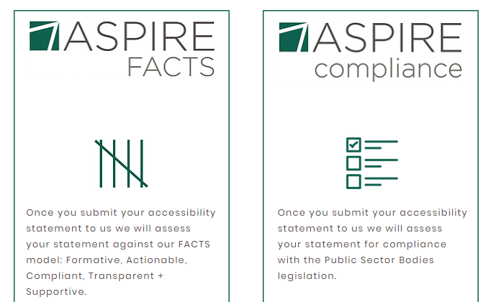
ASPIRE education review process
Notes:
If you're worried about your accessibility statement we can look at it with you, either helping you to ensure it is a genuinely useful tool for students or, if you're not at that stage it, making sure you at least take the compliance boxes for government digital services audits.

Slide 47
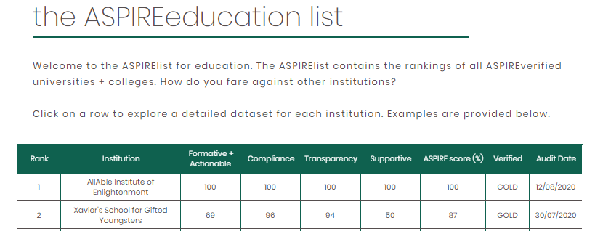
ASPIRE list
Notes:
Organisations that want to ensure their accessibility statements are genuinely useful for users can opt into our verification service where we score you on objective criteria and award you a badge.

Slide 48
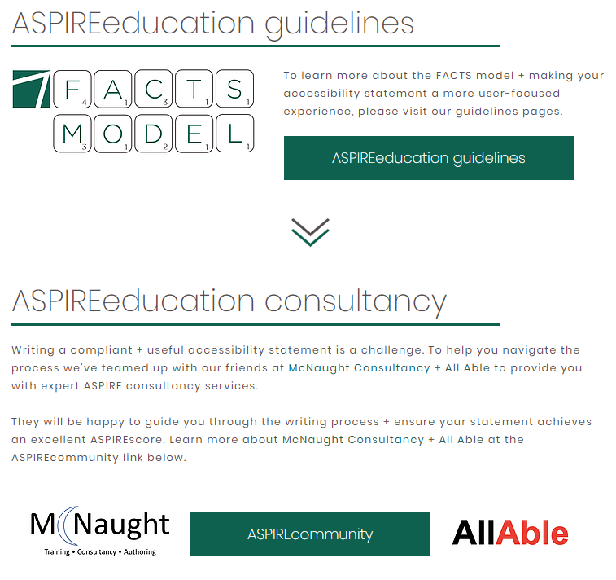
Free guidelines or bespoke support
Notes:
We have made the facts model scoring criteria available as a creative Commons document so even if an organisation doesn't want commercial support in creating high quality accessibility statement, they can use the model to check their own statements. For organisations wanting bespoke support and guidance, we offer a consultancy service at a day or half day rate. We ensure objectivity by insisting that scoring of your accessibility statement has to be completed by an organisation that didn't advise on it.

Slide 49




NEW SERVICE
NEW SERVICE

Slide 50

third party vendors

Slide 51


managing the ecosystem

Slide 52

introducing

Slide 53

searchBOXhost
searchBOX favourites integration
vendor list + statement links
branded page (logo + URL)
bespoke marketing copy
contact information + links
£20 per month

Slide 54




DIRECTORY
the most comprehensive source of accessible content + contact information
FINDER
third-party search functionality for your accessibility statement
EXCHANGE
sign up for searchBOX + ASPIRE updates, lunchBOX interviews, new feature requests, multiple vendor uploads
REACH
found a vendor without a statement?
let us know + we’ll encourage them to tell their accessibility story
HOST
all your searchBOX favourites hosted on a bespoke, branded page to solve your third-party statement issues

Slide 55

your vendors
gift-wrapped

Slide 56
panel

Slide 57


Mark McCallum + Ian Smith
Gavin Henrick
George Rhodes + Ben Watson
Amy Low + Helen Wickes
Alistair McNaught
Huw Alexander

Slide 58
thank you
aspire@textboxdigital.com
@ASPIRElist
textboxdigital.com/aspire-home
SLIDES + VIDEO

