Slide 1
ASPIREeducation Accessibility Statement Survey Results
Notes:
The title of the presentation is ASPIRE education Accessibility Statement Survey Results.

Slide 2
How ready is your institution for the launch of the new Public Sector Bodies Accessibility Regulations on 23 September?
Notes:
How ready is your institution for the launch of the new Public Sector Bodies Accessibility Regulations on 23 September?
An icon of a runner at their marks and ready to go.

Slide 3
We have audited all our key systems and have identified their accessibility strengths and weaknesses.
Notes:
We have audited all our key systems and have identified their accessibility strengths and weaknesses.
Pie chart data: Strongly Agree, 10 per cent. Agree, 45 per cent. Disagree, 32 per cent. Strongly disagree, 13 per cent.

Slide 4
We have improved the accessibility of all the systems within our control.
Notes:
We have improved the accessibility of all the systems within our control.
Pie chart data: Strongly Agree, 3 per cent. Agree, 50 per cent, Disagree, 30 per cent. Strongly disagree, 17 per cent.

Slide 5
We have prepared an accessibility statement for all our key systems.
Notes:
We have prepared an accessibility statement for all our key systems.
Pie chart data: Strongly agree, 3 per cent. Agree, 40 per cent. Disagree, 47 per cent. Strongly disagree, 10 per cent.

Slide 6
What are the most challenging aspects about writing an accessibility statement?
Notes:
What are the most challenging aspects about writing an accessibility statement?
Doughnut chart data as follows.
Addressing third party content, 23 per cent.
Assessing and justifying disproportionate burden, 18 per cent.
Identifying non-compliant content, 18 per cent.
Making the statement user-focused and meaningful, 12 per cent.
Writing in plain English about technical matters, 12 per cent.
Identifying exceptions, 10 per cent.
Colleagues holding different meanings of the term, compliant, 1 per cent.
Getting teams responsible to write them, 1 per cent.
Identifying scope, 1 per cent.
Lack of ownership, 1 per cent.
Pulling it together to cover multiple component platforms, 1 per cent.
Producing evidence of testing, 1 per cent.

Slide 7
How confident are you that your accessibility statement(s) is compliant with the Government Digital Services accessibility statement requirements? Out of 10.
Average score 6.57
Notes:
How confident are you that your accessibility statement(s) is compliant with the Government Digital Services accessibility statement requirements? Out of 10.
Score of 1 received 3.33 per cent.
Score of 2 received 0 per cent.
Score of 3 received 6.67 per cent.
Score of 4 received 0 per cent.
Score of 5 received 20 per cent.
Score of 6 received 13.33 per cent.
Score of 7 received 16.67 per cent.
Score of 8 received 26.67 per cent.
Score of 9 received 10.00 per cent.
Score of 10 received 3.33 per cent.

Slide 8
How confident are you that your accessibility statement is genuinely useful to disabled students? Out of 10.
Average score
5.33
Notes:
How confident are you that your accessibility statement is genuinely useful to disabled students? Out of 10.
Score of 1 received 6.67 per cent.
Score of 2 received 6.67 per cent.
Score of 3 received 3.33 per cent.
Score of 4 received 6.67 per cent.
Score of 5 received 23.33 per cent.
Score of 6 received 23.33 per cent.
Score of 7 received 23.33 per cent.
Score of 8 received 3.33 per cent.
Score of 9 received 3.33 per cent.
No scores for 10.

Slide 9
Who is responsible for creating and maintaining accessibility statements at your institution?
Notes:
Who is responsible for creating and maintaining accessibility statements at your institution?
Pie chart data as follows.
System owner, 48 per cent.
Central team, 21 per cent.
Developers and web team, 7 per cent.
Me, 7 per cent.
Small team for a large department in an even larger institution, 4 per cent.
Department or course leader, 4 per cent.
Digital accessibility working group, 3 per cent.
eLearning team, 3 per cent.
Learning technologist, allegedly, 3 per cent.

Slide 10
What is your institution's approach to course/module-level accessibility statements?
Notes:
What is your institution's approach to course/module-level accessibility statements?
Pie chart data as follows.
There is only a top-level statement for the learning platform, 90 per cent.
There is a statement at school or faculty level, 10 per cent.
There is a statement at course level, zero per cent.

Slide 11
What are the main strengths or weaknesses of your institution's accessibility statement(s)?
Notes:
What are the main strengths or weaknesses of your institution's accessibility statement(s)?
Stacked bar chart data as follows.
It is written in plain English. Agree, 93 per cent. Disagree, 7 per cent.
It is accurate and detailed. Strongly Agree, 7 per cent. Agree, 53 per cent. Disagree, 40 per cent.
It is a transparent account of our accessibility priorities. Strongly Agree, 19 per cent. Agree, 42 per cent. Disagree, 29 per cent. Strongly Disagree, 10 per cent.
It contains practical guidance for a better website experience. Strongly Agree, 13 per cent. Agree, 53 per cent. Disagree, 27 per cent. Strongly Disagree, 7 per cent.
It provides clear links to additional support. Strongly Agree, 17 per cent. Agree, 67 per cent. Disagree, 10 per cent. Strongly Disagree, 7 per cent.
It is compliant with the regulations. Strongly Agree, 13 per cent. Agree, 63 per cent. Disagree, 17 per cent. Strongly Disagree, 7 per cent.

Slide 12
How does your statement(s) compare to other institutions?
Notes:
How does your statement(s) compare to other institutions?
Pie chart data as follows.
Don’t know, 45 per cent.
Favourably, 26 per cent.
About the same, 23 per cent.
Unfavourably, 6 per cent.

Slide 13
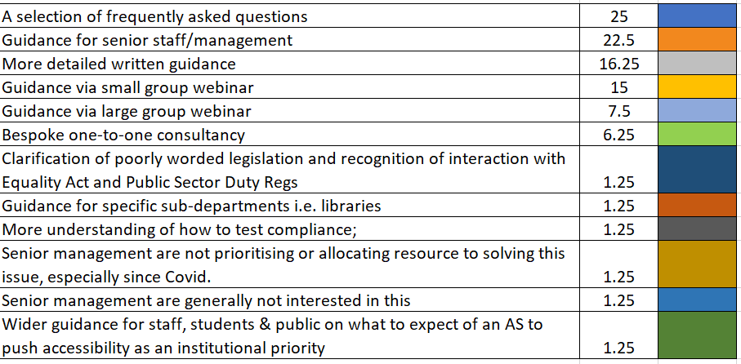
What would help you with understanding and implementing the Public Sector Bodies accessibility regulations?
Notes:
A selection of frequently asked questions, 25 per cent.
Guidance for senior staff/management, 23 per cent.
More detailed written guidance, 17 per cent.
Guidance via small group webinar, 15 per cent.
Guidance via large group webinar, 8 per cent.
Bespoke one-to-one consultancy, 6 per cent.
Clarification of poorly worded legislation and recognition of interaction with Equality Act and Public Sector Duty Regs, 1.25 per cent.
Guidance for specific sub-departments i.e. libraries, 1.25 per cent.
More understanding of how to test compliance, 1.25 per cent.
Senior mgt are not prioritising or allocating resource to solving this issue either before and especially since Covid, 1.25 per cent.
SMs are generally not interested in this, 1.25 per cent.
Wider guidance for staff, students & public on what to expect of an AS to push accessibility as an institutional priority, 1.25 per cent.

Slide 14
How are you remediating existing content for accessibility?
Notes:
How are you remediating existing content for accessibility?
Pie chart data as follows.
We are remediating manually in-house, 48 per cent.
We are claiming disproportionate burden, 20 per cent.
We are remediating using an automated service, 18 per cent.
We are looking for help on this issue, 10 per cent.
We are outsourcing the content for remediation, 4 per cent.

Slide 15
What are the biggest barriers to implementing accessible practices at your institution?
Notes:
What are the biggest barriers to implementing accessible practices at your institution?
Pie chart data as follows.
Time, 18 per cent.
Staffing, 18 per cent.
Management Buy-in, 18 per cent.
Expertise, 16 per cent.
Budgetary concerns, 12 per cent.
Lack of Clear Guidance, 6 per cent.
Disjointed Approach, 2 per cent.
Lack of training and understanding on requirements and writing statement, 2 per cent.
Working remotely when testing without access campus assistive technology, 2 per cent.
Lack of institutional focus, Functioning central team/roles, 2 per cent.
Institution wide lack of digital accessibility skills & knowledge, 2 per cent.
Lack of institutional focus, 2 per cent.
Volume of online content, 2 per cent.

Slide 16
What are the most useful tools that you use in testing your website for accessibility?
Notes:
What are the most useful tools that you use in testing your website for accessibility?
Pie chart data as follows.
WAVE, 26 per cent.
Blackboard Ally, 11 per cent.
SiteImprove, 11 per cent.
NVDA, 6 per cent.
AXE, 6 per cent.
Microsoft Accessibility Checker, 6 per cent.
Zoom Text, 6 per cent.
ChromeVox, 3 per cent.
Accessibility Insights, 3 per cent.
Chrome Lighthouse, 3 per cent.
Firefox Accessibility, 3 per cent.
JAWS, 3 per cent.
Read and Write Gold, 3 per cent.
Tota11y, 3 per cent.
ANDI, 3 per cent.
LexDis Toolkit, 3 per cent.
Silktide, 3 per cent.

Slide 17
Where do you get your most valuable and practical information about accessibility regulations?
Notes:
Where do you get your most valuable and practical information about accessibility regulations?
Pie chart data as follows.
Jisc Mailing List/Teams Community, 37 per cent.
GDS, 24 per cent.
AbilityNet, 12 per cent.
W3C, 7 per cent.
Alistair McNaught, 5 per cent.
Colleagues, 5 per cent.
Other universities, 3 per cent.
Legal Advice, 3 per cent.
Paciello Group, 2 per cent.
LexDis 2 per cent.

Slide 18
What is current priority in meeting the new regulations?
Notes:
What is the current priority in meeting the new regulations?
Pie chart data
Writing the accessibility statement, 36 per cent.
Auditing the website to identify issues, 24 per cent.
Remediating Existing Content, 24 per cent.
Raising staff awareness, 4 per cent.
Replacing a particularly old and inaccessible system, 2 per cent.
Stem the flow of inaccessible content, 2 per cent.
Third party and satellite systems, 2 per cent.
Training staff and students, 2 per cent.
Video and audio, 2 per cent.
Gaining governance institution wide, 2 per cent.

